Slide 1


Smart Shot:Iot Nerf Turret With Bluetooth Control
Submitted By:- Yugal Kumar

Slide 2
Index of Contents
Introduction
Problem Statement
Challenges & Solutions
Feasibility Study
Technology Stack
3-D Model
Hardware Components
Connection Diagram
Budget
Conclusion
References

Slide 3
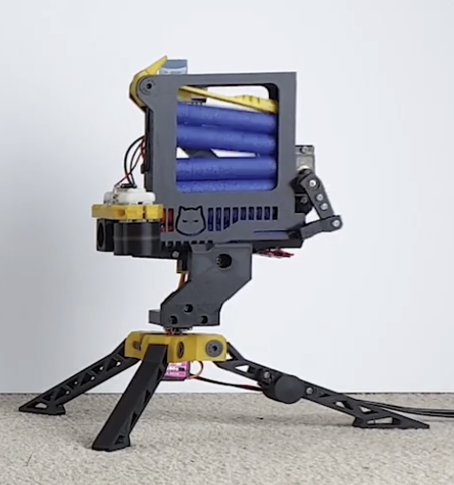
Introduction
To integrate IoT and robotic into a Nerf gun platform.
Utilizes an Arduino Nano R3 as the main control unit.
A tilt and pan system driven by MG90s servo motors enables precise aiming.
Equipped with two 130 DC motors to power the dart launching mechanism.
Features wireless control via the HC-05 Bluetooth module, allowing remote operation.
Powered by a 12V 2.5A adapter to ensure reliable and stable performance.
Designed for interactive use and experimentation in embedded systems and robotics.
Offers a compact, modular structure for ease of modification and upgrades.
Figure 1 : Bluetooth NERF Gun

Slide 4
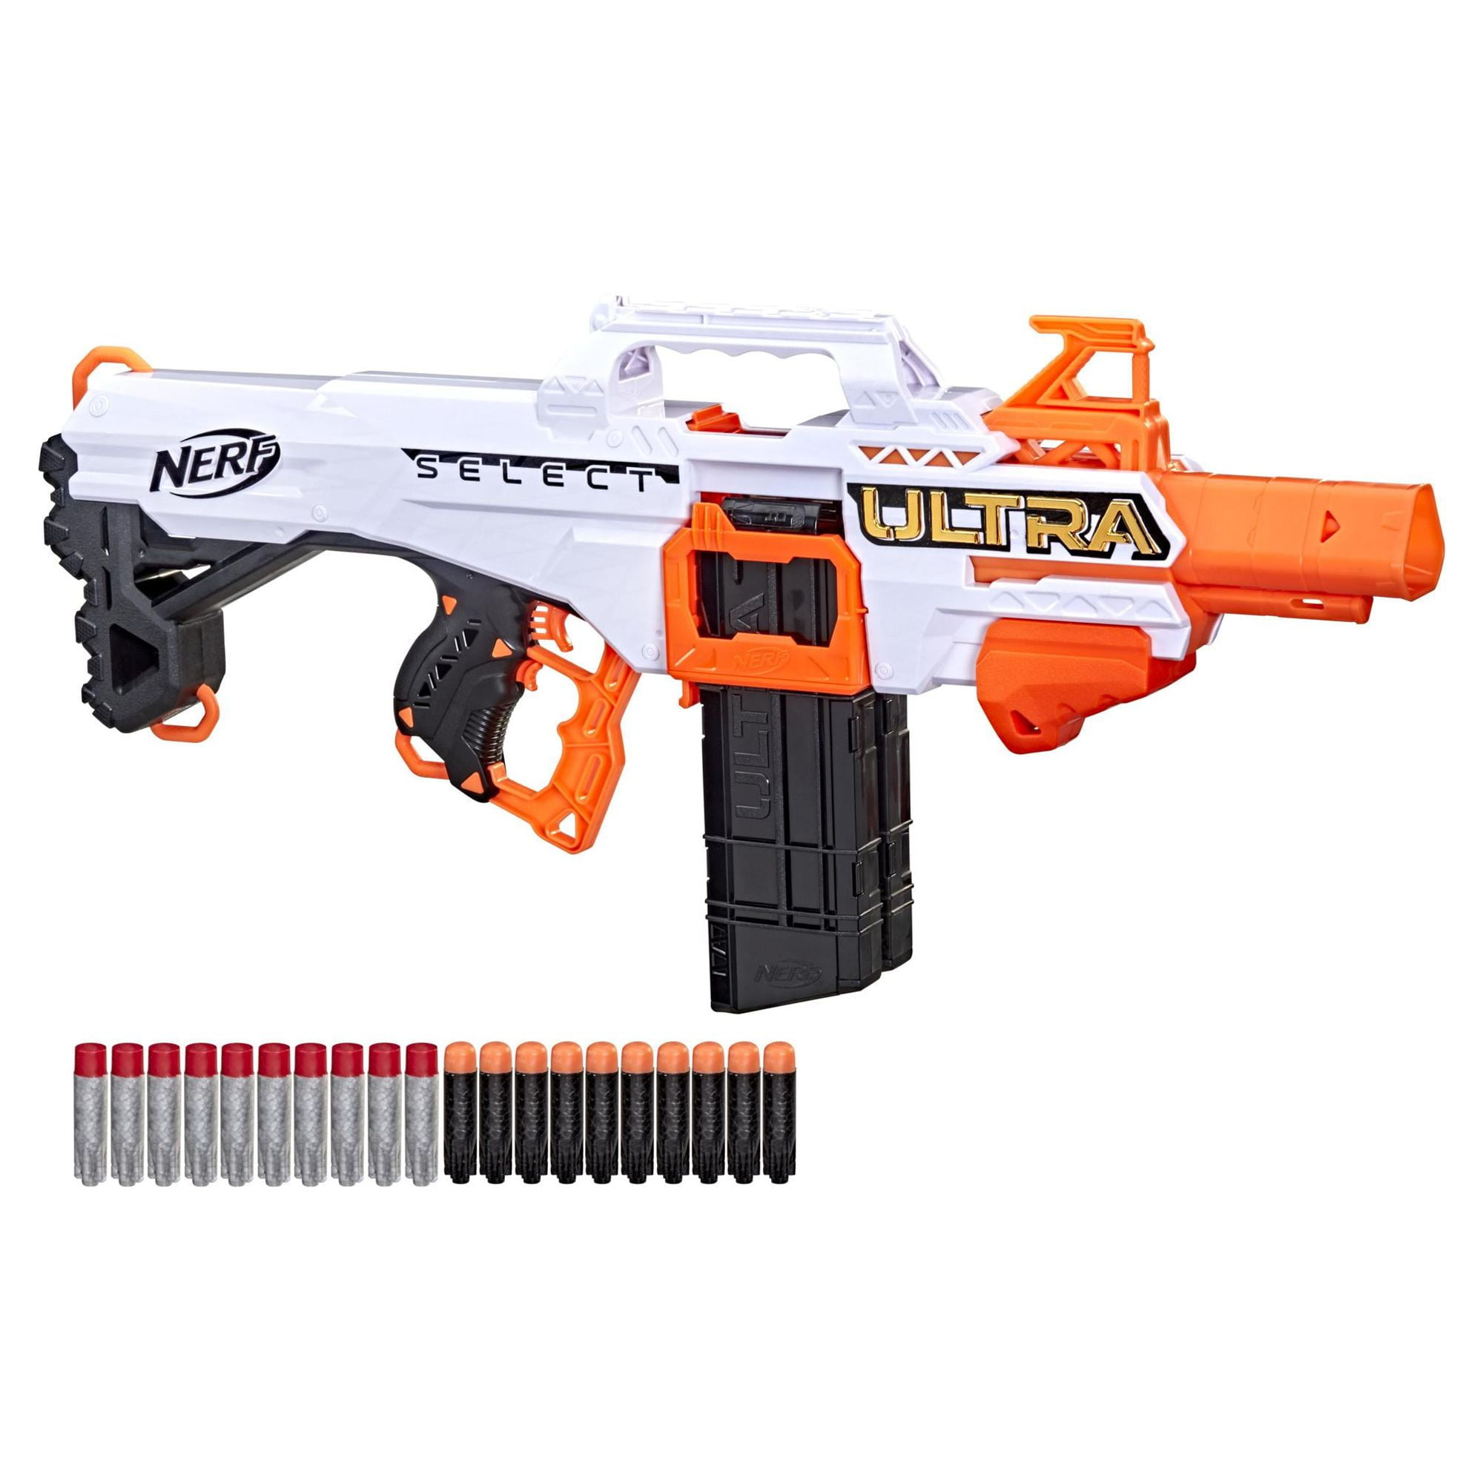
Problem Statement
Conventional Nerf guns lack advanced features such as remote or automated control.
They offer minimal support for interactive or dynamic gameplay.
This project upgrades the traditional setup by integrating automation and Bluetooth-based remote control
Enhances user engagement through smarter, more responsive operation.
Bridges the gap between basic toy design and modern IoT-enabled robotics applications.
Figure 2 : NERF Gun

Slide 5
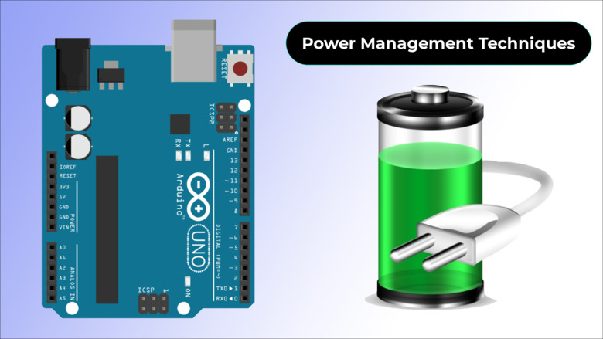
Challenges & Solutions
Communication Delay: Improve Bluetooth responsiveness by configuring appropriate baud rates for efficient data transmission.
Power Efficiency: Use a separate and stable power source for the motors to prevent voltage drops and ensure consistent performance.
Mechanical Precision: Perform careful calibration of the tilt and pan mechanism to achieve accurate and smooth turret movements.
These optimizations collectively enhance system reliability, responsiveness, and mechanical accuracy during remote operation.
Figure 3 : Power Managment

Slide 6
Feasibility Study
Technical Feasibility: The system uses compatible components such as the Arduino Nano, HC-05 Bluetooth module, DC motors, and MG90s servos, all easily integrated. Software development is supported by the Arduino IDE and widely available Bluetooth libraries.
Operational Feasibility: Assembly is straightforward, requiring only basic tools like screws and rubber bands. The Bluetooth remote control ensures simple and intuitive operation.
Economic Feasibility: The project remains cost-effective, with affordable components. Additionally, a Li-ion battery pack can be used as an alternative power source, offering improved energy efficiency.

Slide 7
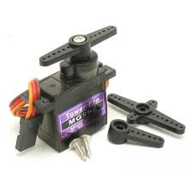
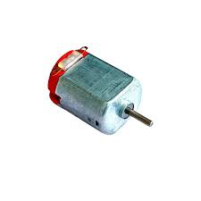
Technology Stack
Hardware Components
Arduino Nano R3 (main controller)
MG-90s servos (tilt & pan)
130 DC motors (dart firing)
HC-05 Bluetooth module (wireless control)
LM2596 buck converter (power regulation)
Various wiring components
Software Used
Arduino IDE (code development)[11]
Android App (remote control interface)[10]
Python & UI files repository (for additional functionalities)
Figure 4: MG-90s servo
Figure 5: D.C Motor

Slide 8
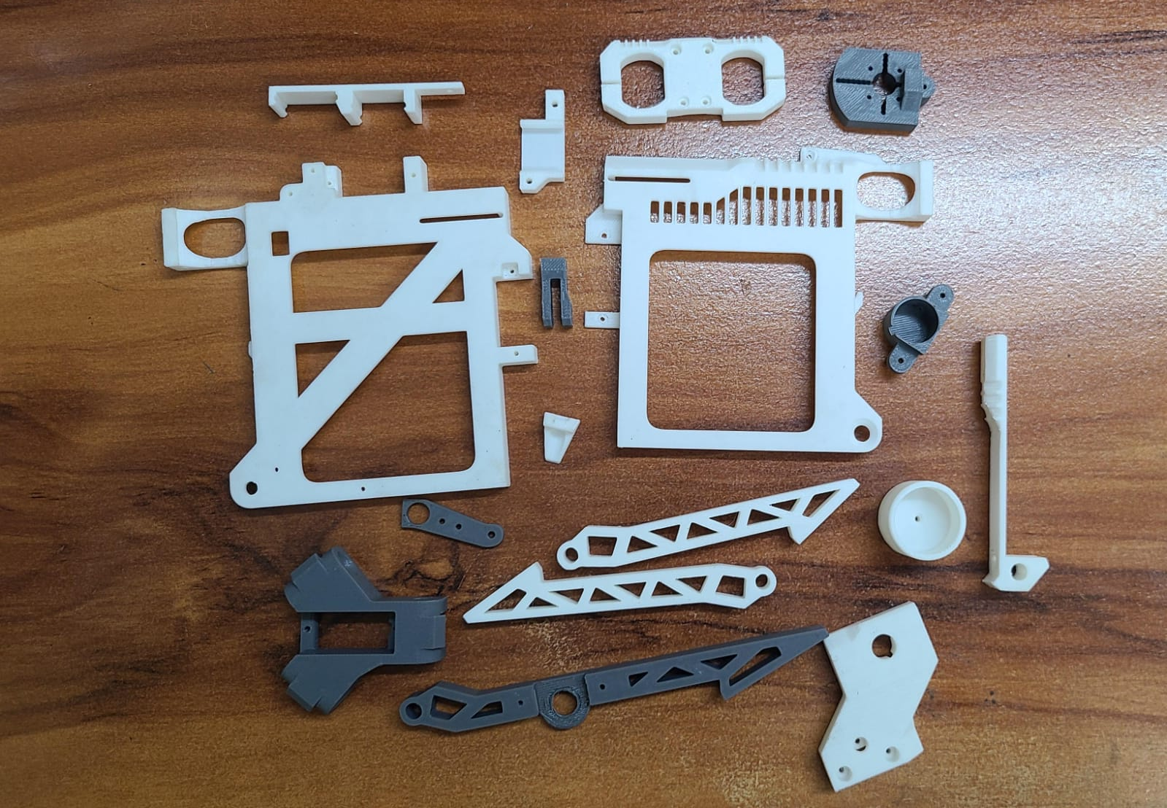
3-D Model
3D Model Printing Overview
1. Process:
Design a 3D model using software.
Slice it into layers using slicing software.
Print using a 3D printer.
Post-process for finishing touches.
2. Common 3D Printing Technologies:
FDM (Fused Deposition Modeling) – Uses melted plastic filaments.
SLS (Selective Laser Sintering) – Uses powdered material fused by a laser.
3. Materials Used:
Plastics (PLA, ABS, PETG)
Resins (for SLA printing)
Figure 6: 3-D model components

Slide 9
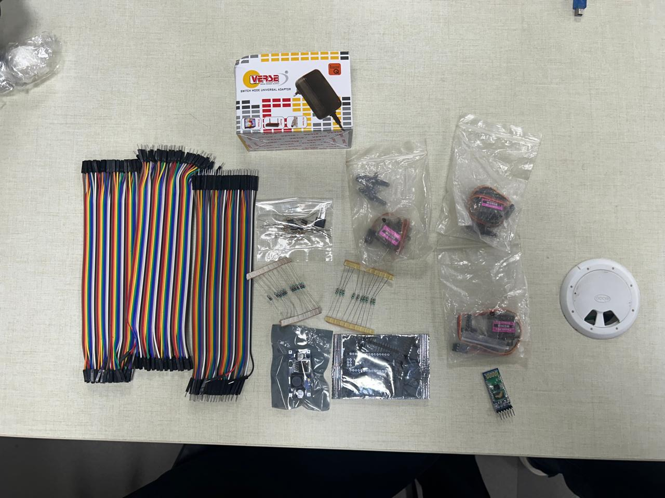
Hardware Components
The hardware table lists the components used in the system, detailing their specifications and roles. It serves as a reference for understanding each hardware element's function and how they integrate to ensure optimal system performance.
2.
S.NO. | Parts | Quantity
1. | Jumper Wires | 3- Packs
2. | 12V Power Supply | 1
3. | Arduino Nano R3 | 1
4. | Bluetooth Module | 1
5. | MG-90s Servos | 3
6. | Buck Converter | 1
5.
1.
3.
6.
4.
Figure 7: Hardware components

Slide 10
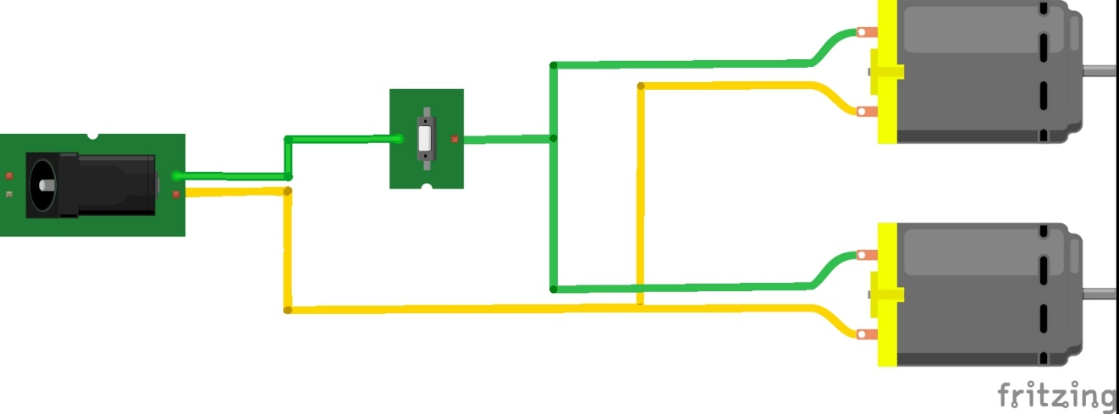
Connection Diagram-
DC motor Diagram-
The connection diagram shows a 12V power jack linked to a switch that controls two 130 DC motors. The power jack’s positive terminal connects to the switch, then splits to power both motors. The negative terminal goes directly to the motors’ negative ends. This setup allows both motors to run simultaneously when the switch is turned on, enabling simple and effective power control.
Figure 8: Connection Diagram of DC Motors, Switch and Power jack

Slide 11
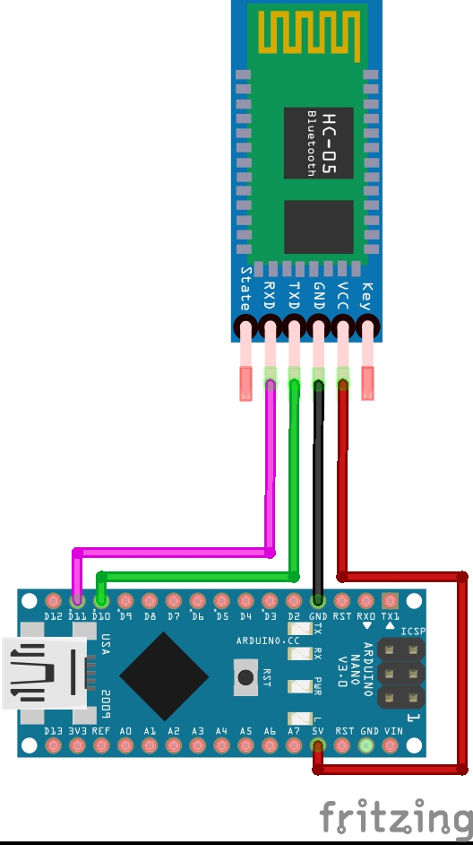
Connection Diagram-
HC-05 Bluetooth module wiring
The connection diagram shows the HC-05 Bluetooth module linked to an Arduino Nano. The HC-05's VCC and GND are connected to the Nano’s 5V and GND for power. TXD and RXD are connected to D2 and D3, respectively, enabling software serial communication for Bluetooth-based data exchange with external devices.
Figure 9: Connection Diagram of Arduino Nano and HC-05

Slide 12
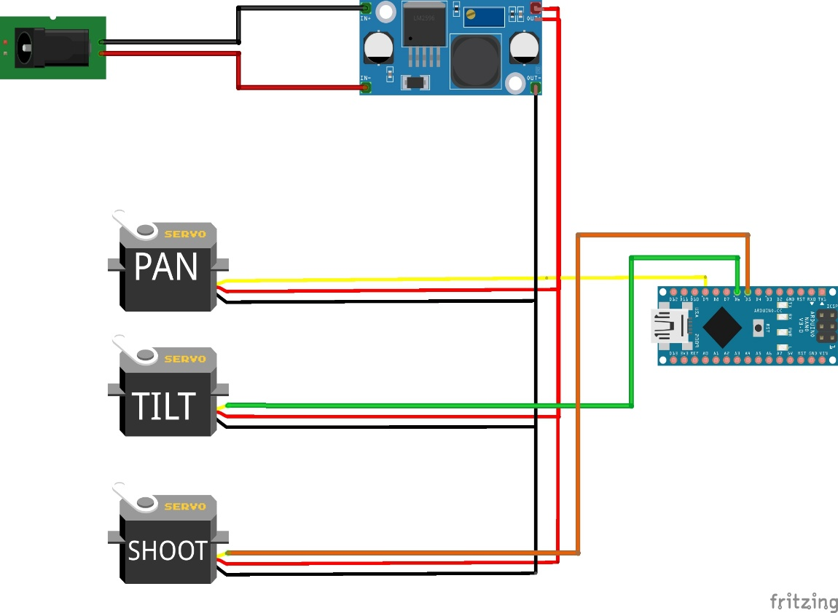
Connection Diagram
Servo motors connection Diagram
The connection diagram includes three servos, a buck converter, a power jack, and an Arduino Nano. The servos receive stable power from the buck converter, which is fed by the power jack. The Arduino Nano serves as the central controller, managing servo movements based on input commands, with all components connected to ensure reliable system operation.
Figure 10: Connection Diagram of Servo Motors, Arduino Nano, Buck Converter and Power jack

Slide 13
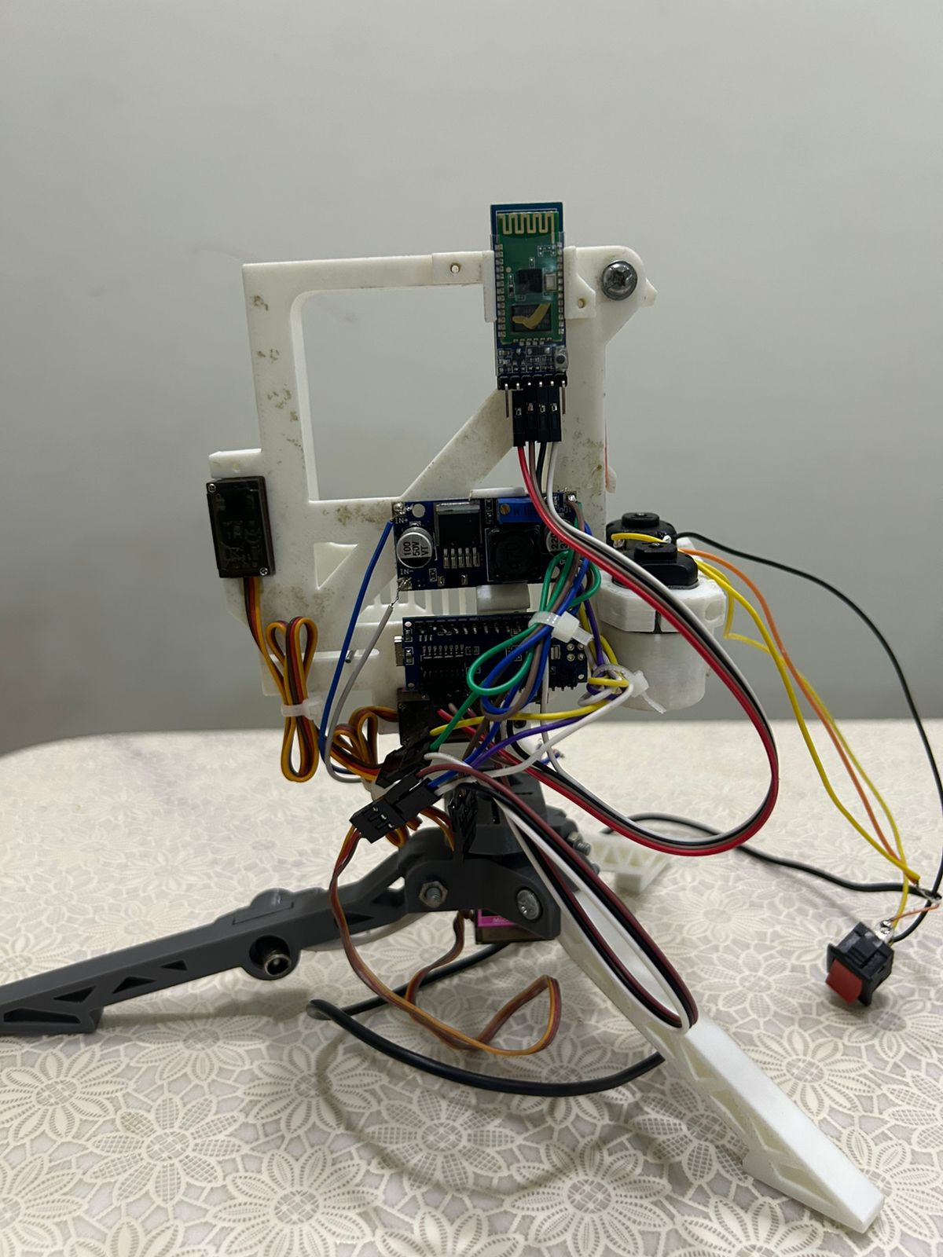
Budget
3-D model Printed Parts - ₹2500/-
Hardware Components - ₹2000/-
Overall Budget - ₹4500/-
Figure 11: Final Model

Slide 14
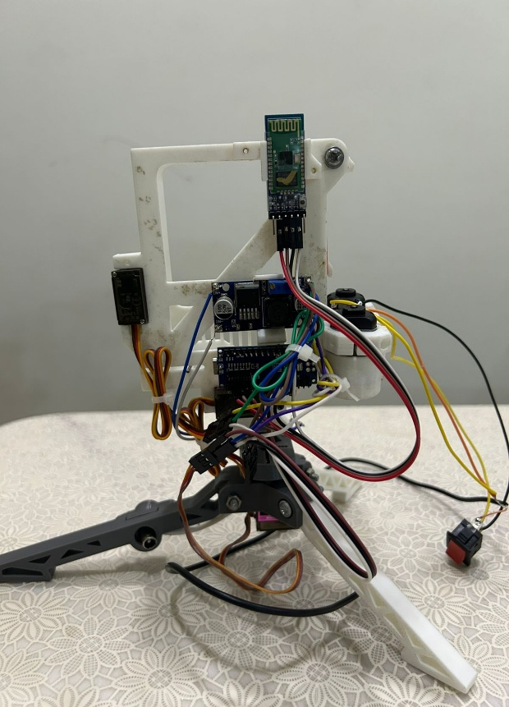
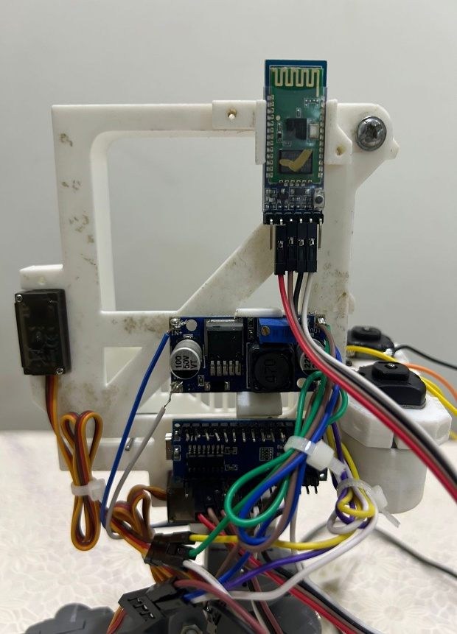
Analysis and Future Work
The system combines IoT and robotics using affordable components like the Arduino Nano and HC-05 module, offering stable control, power regulation, and accurate aiming. Minor latency from Bluetooth and the need for calibration are noted. Future improvements include using Wi-Fi/BLE, adding sensors for auto-targeting, and integrating vision systems. Its modular design supports easy upgrades and experimentation.
Video Link of Project
https://drive.google.com/file/d/13aaMvZ8cC9n20jFoKirqlNgucj_WoWrF/view?usp=drive_link
Figure 12: Closeup of Final Model

Slide 15
Conclusion
The Smart Shot project demonstrates a functional integration of IoT and embedded systems using Bluetooth-controlled robotics.
Utilizes widely available components like Arduino Nano, MG90s servo motors, HC-05 Bluetooth module, and LM2596 buck converter.
Achieves real-time control over pan, tilt, and shooting mechanisms via a custom Android app.
The design prioritizes modularity, low cost, and educational value—ideal for students, hobbyists, and demonstrations.
Simplifies complex engineering concepts such as PWM, UART serial communication, and power regulation.
Offers potential for future improvements like camera-based targeting, AI integration, or autonomous operation.
Proves to be a reliable, responsive, and interactive system that enhances learning and showcases modern wireless control techniques.

Slide 16
References
A. Al-Fuqaha, M. Guizani, M. Mohammadi, M. Aledhari, and M. Ayyash, "Internet of Things: A Survey on Enabling Technologies, Protocols, and Applications," IEEE Communications Surveys & Tutorials, vol. 17, no. 4, pp. 2347–2376, 2015.
Y. Zhang and J. Wen, "An IoT electric business model based on the protocol of MQTT," 2016 18th International Conference on Advanced Communication Technology (ICACT), PyeongChang, South Korea, 2016, pp. 434–437.
H. M. Hashemian, "State-of-the-Art in Nuclear Power Plant Control and Instrumentation and Its Evolution Into the Next Century," IEEE Transactions on Nuclear Science, vol. 47, no. 3, pp. 1321–1328, Jun. 2000.
S. D. T. Kelly and N. K. Suryadevara, "Internet of Things (IoT) based sensor network for smart buildings," 2013 IEEE International Conference on Systems, Man, and Cybernetics, Manchester, UK, 2013.
A. S. Raut, P. N. Chavan, and N. N. Patil, "Smart Surveillance Security System Using IoT and Raspberry Pi," 2018 Second International Conference on Intelligent Computing and Control Systems (ICICCS), Madurai, India, 2018.

Slide 17
References
J. Gubbi, R. Buyya, S. Marusic, and M. Palaniswami, "Internet of Things (IoT): A vision, architectural elements, and future directions," Future Generation Computer Systems, vol. 29, no. 7, pp. 1645–1660, Sep. 2013.
N. T. Ayrekar, S. Patil, A. Borse, and K. Patil, "Design and implementation of a robotic arm using Arduino," 2017 International Conference on Computing, Communication, Control and Automation (ICCUBEA), Pune, India, 2017.
R. Motwani, D. Rajpoot, and M. Sharma, “Bluetooth Controlled Surveillance Rover,” International Journal of Scientific Research in Computer Science, Engineering and Information Technology, vol. 3, no. 3, pp. 1363–1368, 2018.
A. Sharma, A. Kumari, and V. Sharma, "Design and development of Bluetooth controlled car system using Arduino Uno," International Journal of Engineering Research & Technology (IJERT), vol. 6, no. 4, pp. 442–445, Apr. 2017.
D. Mancini and F. Moschetti, “Vision-Based Automatic Nerf Gun Turret,” IDA Labs Research Projects, 2019.
S. Bose and A. Pal, "Design of low-cost IoT based surveillance robot using Raspberry Pi and camera module," International Journal of Engineering Research & Technology, vol. 8, no. 5, 2019

